Slide 1
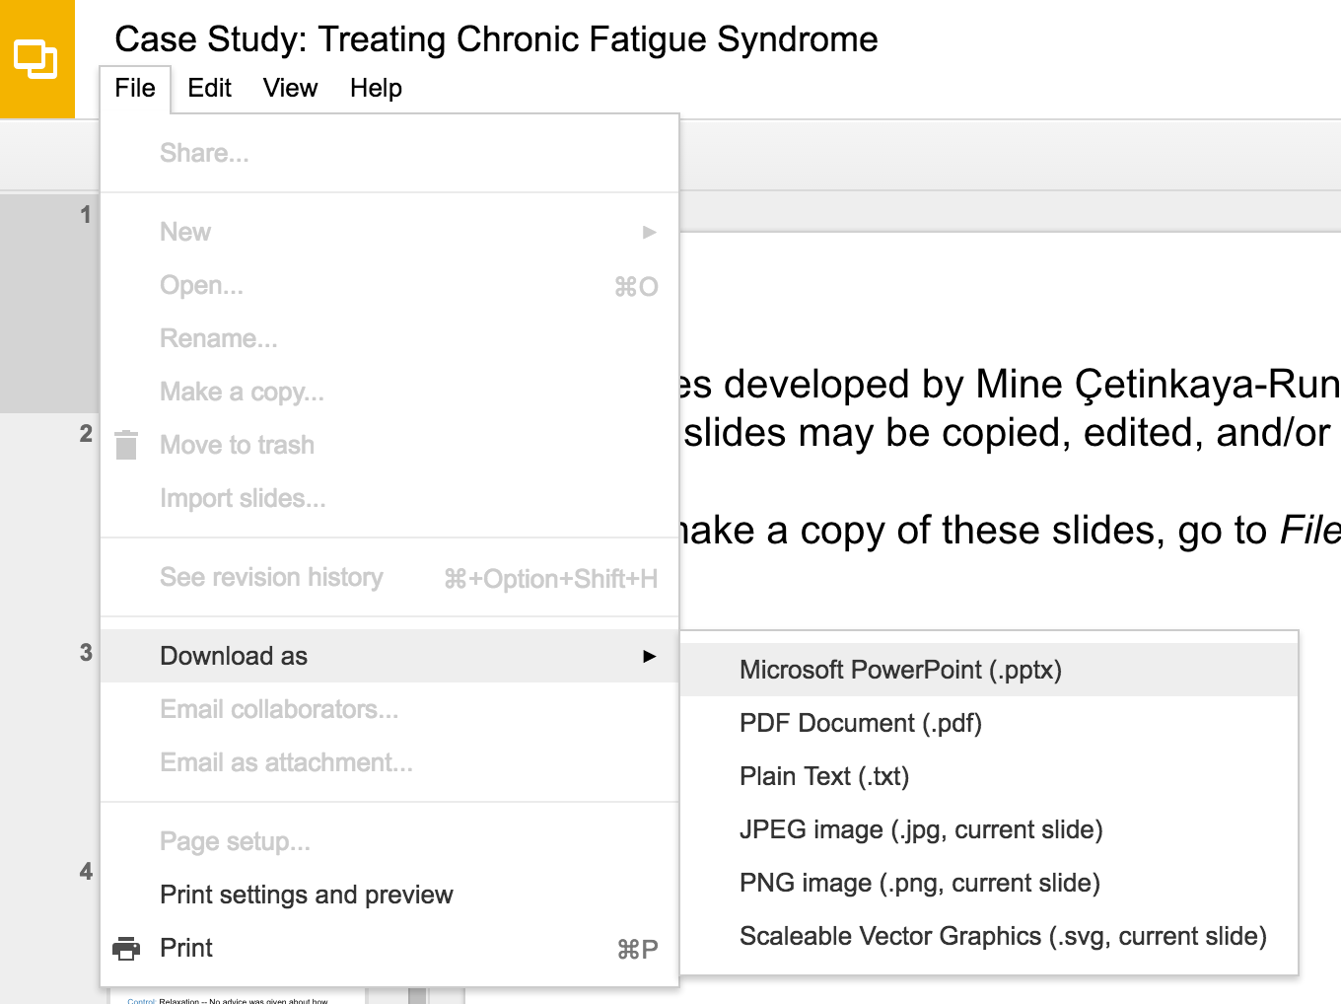
Slides developed by Mine Çetinkaya-Rundel of OpenIntro
Translated from LaTeX to Google Slides by Curry W. Hilton of OpenIntro.
The slides may be copied, edited, and/or shared via the CC BY-SA license
To make a copy of these slides, go to File > Download as > [option], as shown below. Or if you are logged into a Google account, you can choose Make a copy... to create your own version in Google Drive.

Slide 2
Line Fitting,
Residuals, and Correlation

Slide 3
Modeling numerical variables
In this unit we will learn to quantify the relationship between two numerical variables, as well as modeling numerical response variables using a numerical or categorical explanatory variable.

Slide 4
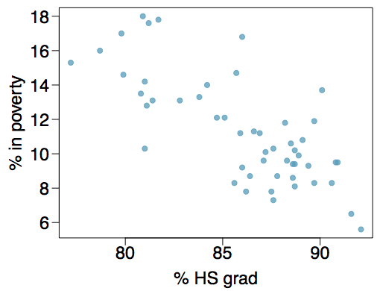
Poverty vs. HS graduate rate
The scatterplot below shows the relationship between HS graduate rate in all 50 US states and DC and the percent of residents who live below the poverty line (income below $23,050 for a family of 4 in 2012).
Response variable?

Slide 5
Poverty vs. HS graduate rate
The scatterplot below shows the relationship between HS graduate rate in all 50 US states and DC and the percent of residents who live below the poverty line (income below $23,050 for a family of 4 in 2012).
Response variable?
% in poverty

Slide 6
Poverty vs. HS graduate rate
The scatterplot below shows the relationship between HS graduate rate in all 50 US states and DC and the percent of residents who live below the poverty line (income below $23,050 for a family of 4 in 2012).
Response variable?
% in poverty
Explanatory variable?

Slide 7
Poverty vs. HS graduate rate
The scatterplot below shows the relationship between HS graduate rate in all 50 US states and DC and the percent of residents who live below the poverty line (income below $23,050 for a family of 4 in 2012).
Response variable?
% in poverty
Explanatory variable?
% HS grad

Slide 8
Poverty vs. HS graduate rate
The scatterplot below shows the relationship between HS graduate rate in all 50 US states and DC and the percent of residents who live below the poverty line (income below $23,050 for a family of 4 in 2012).
Response variable?
% in poverty
Explanatory variable?
% HS grad
Relationship?

Slide 9
Poverty vs. HS graduate rate
The scatterplot below shows the relationship between HS graduate rate in all 50 US states and DC and the percent of residents who live below the poverty line (income below $23,050 for a family of 4 in 2012).
Response variable?
% in poverty
Explanatory variable?
% HS grad
Relationship?
linear, negative, moderately strong

Slide 10

Poverty vs. HS graduate rate
The linear model for predicting poverty from high school graduation rate in the US is
The "hat" is used to signify that this is an estimate.

Slide 11
Poverty vs. HS graduate rate
The linear model for predicting poverty from high school graduation rate in the US is
The "hat" is used to signify that this is an estimate.
The high school graduate rate in Georgia is 85.1%. What poverty level does the model predict for this state?
64.78 − 0.62 x 85.1 = 12.018

Slide 12
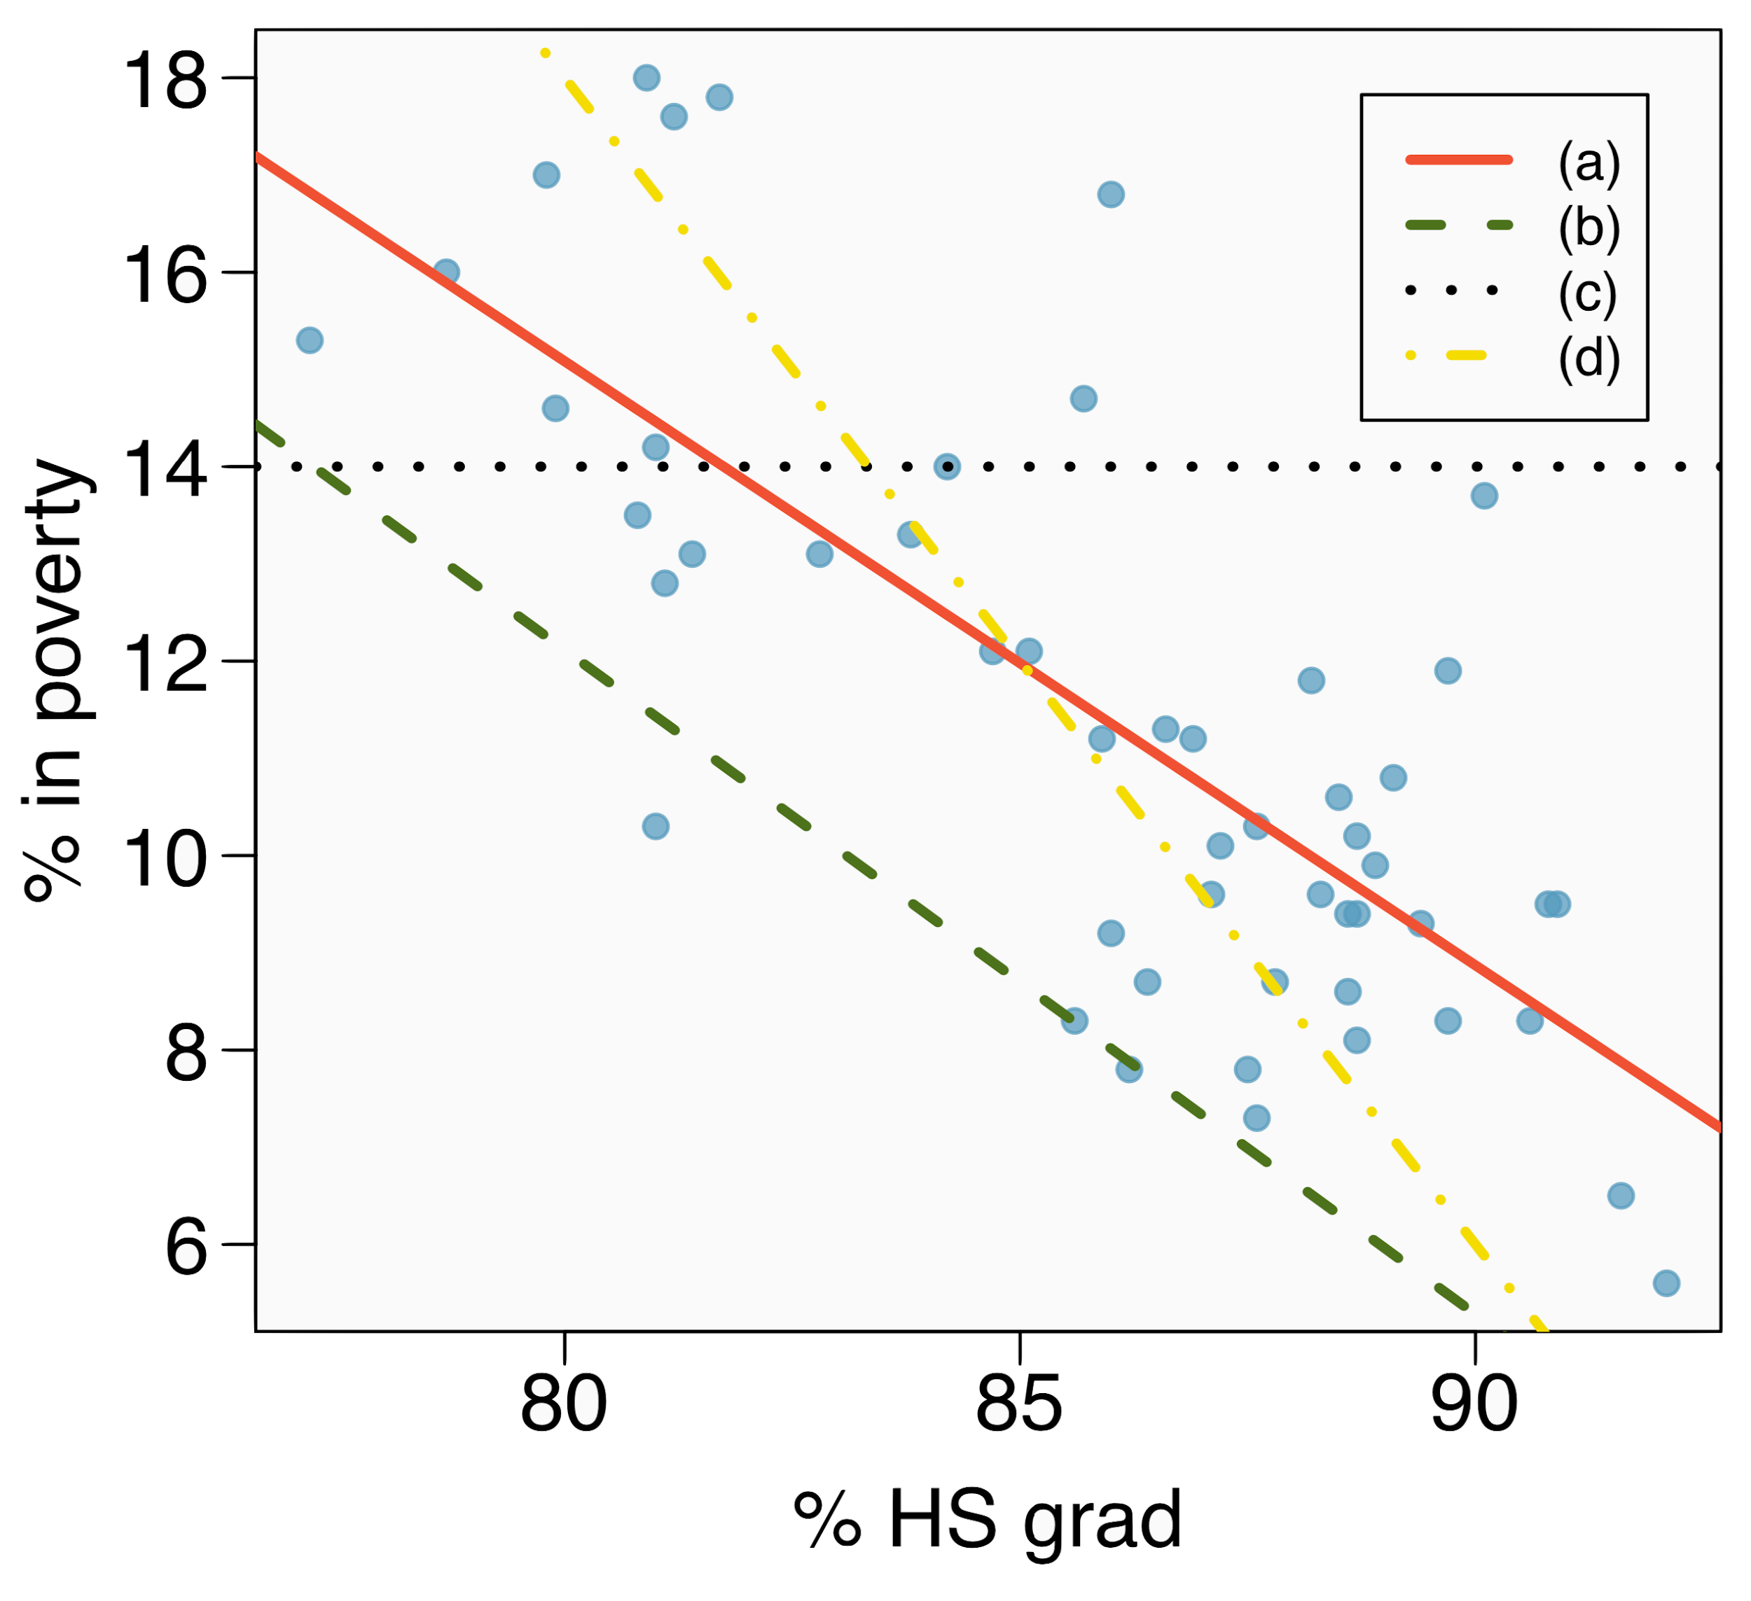
Eyeballing the line
Which of the following appears to be the line that best fits the linear relationship between % in poverty and % HS grad? Choose one.

Slide 13
Eyeballing the line
Which of the following appears to be the line that best fits the linear relationship between % in poverty and % HS grad? Choose one.
(a)

Slide 14
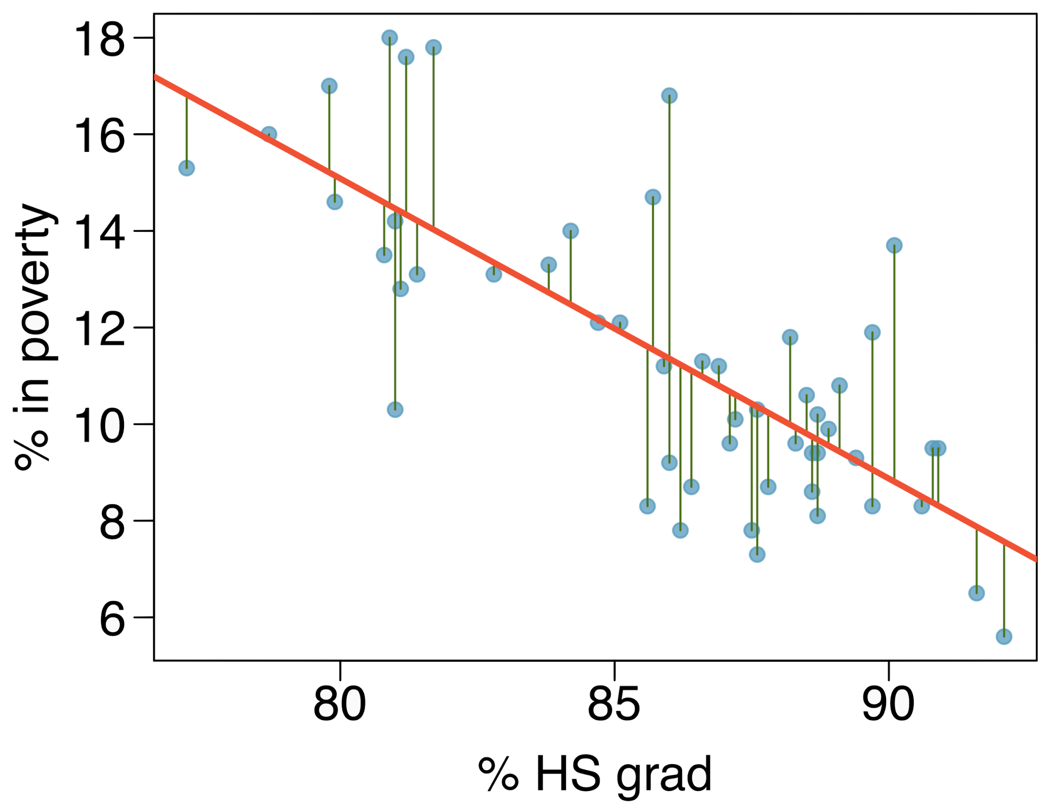
Residuals
Residuals are the leftovers from the model fit:
Data = Fit + Residual

Slide 15
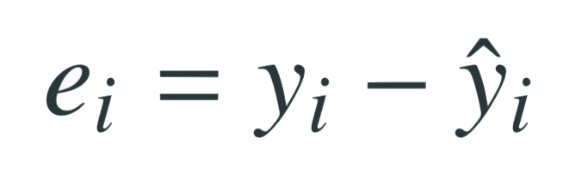
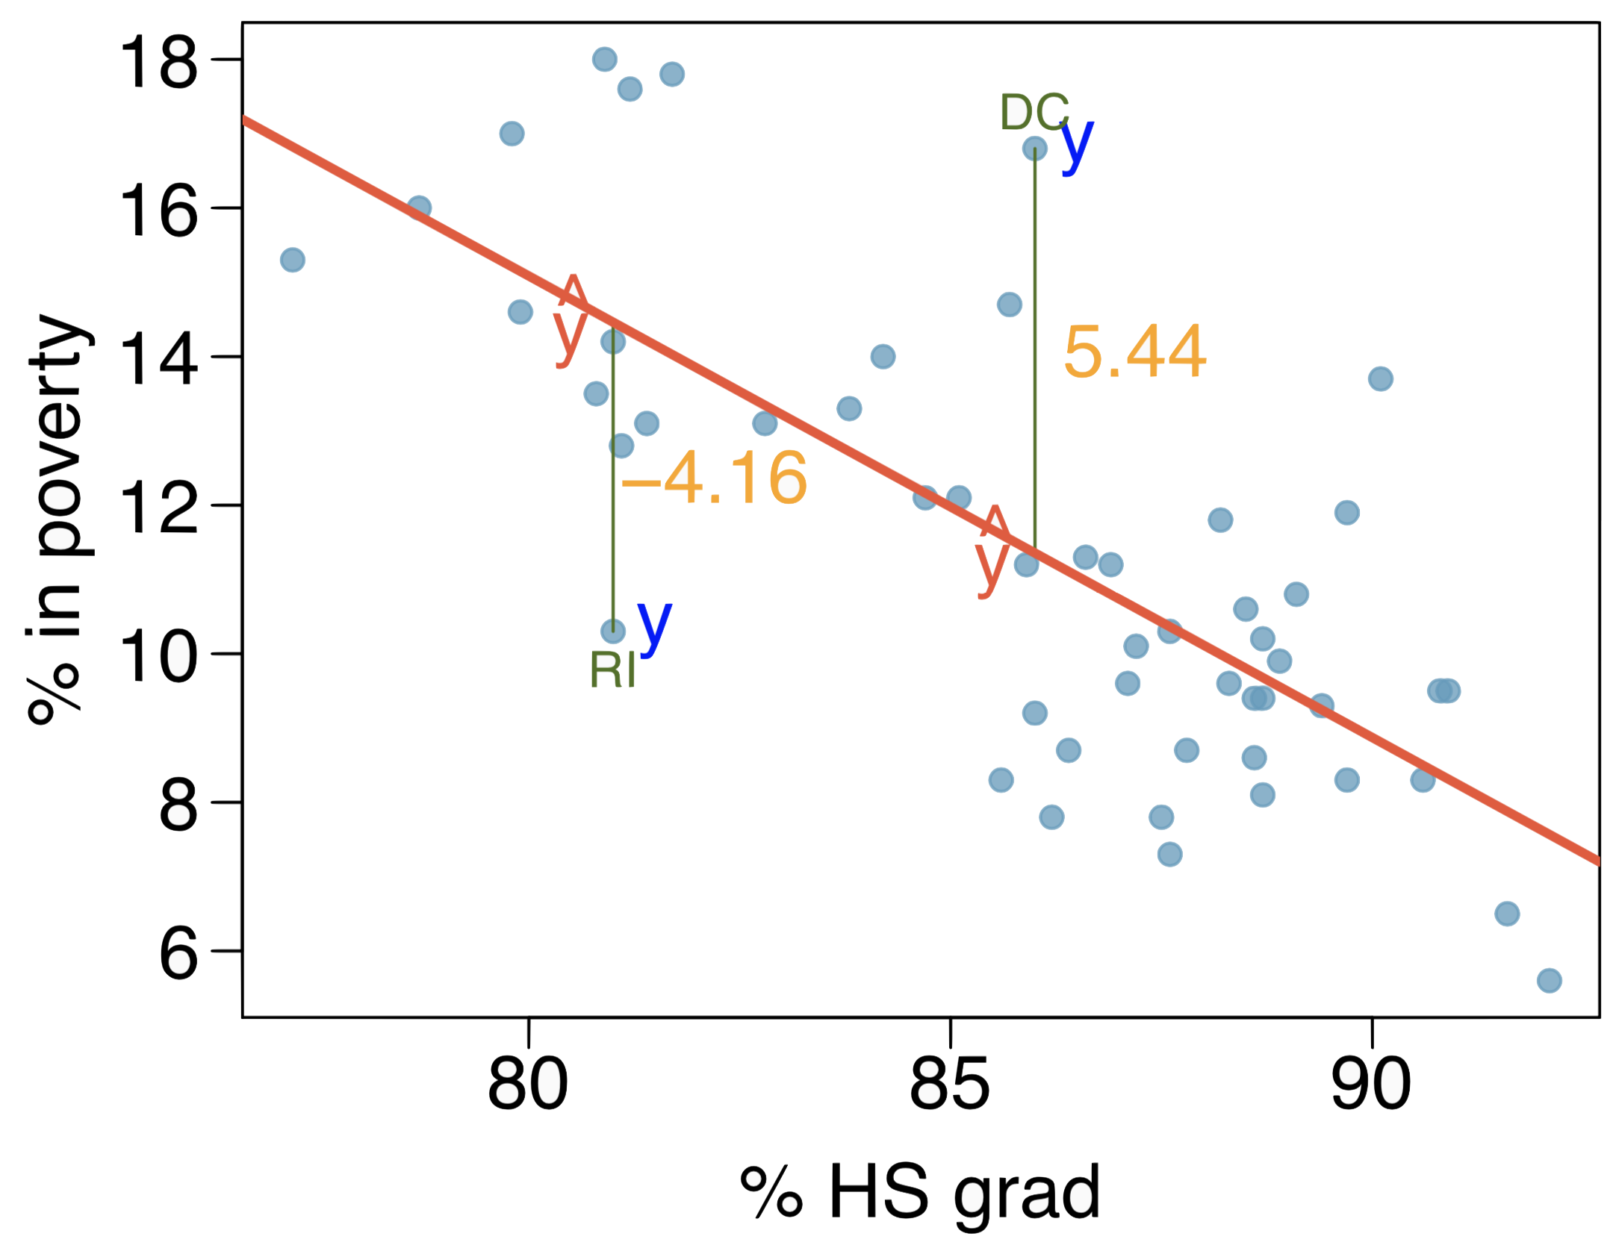
Residuals (cont.)
Residual is the difference between the observed (y_{i}) and predicted ŷ_{i}.

Slide 16
Residuals (cont.)
Residual is the difference between the observed (y_{i}) and predicted ŷ_{i}.
% living in poverty in DC is 5.44% more than predicted.

Slide 17
Residuals (cont.)
Residual is the difference between the observed (y_{i}) and predicted ŷ_{i}.
% living in poverty in DC is 5.44% more than predicted.
% living in poverty in RI is 4.16% less than predicted.

Slide 18
Quantifying the relationship
Correlation describes the strength of the linear association between two variables.

Slide 19
Quantifying the relationship
Correlation describes the strength of the linear association between two variables.
It takes values between -1 (perfect negative) and +1 (perfect positive).

Slide 20
Quantifying the relationship
Correlation describes the strength of the linear association between two variables.
It takes values between -1 (perfect negative) and +1 (perfect positive).
A value of 0 indicates no linear association.

Slide 21
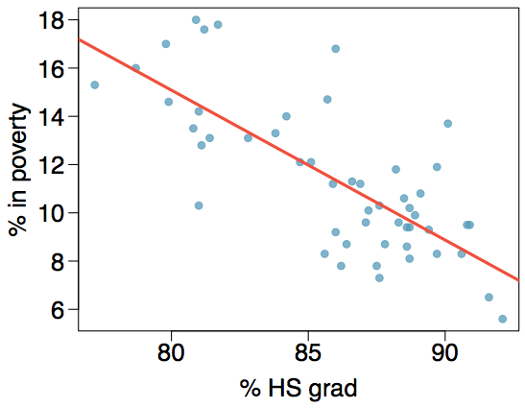
Guessing the correlation
Which of the following is the best guess for the correlation between percent in poverty and percent HS grad?
0.6
-0.75
-0.1
0.02
-1.5

Slide 22
Guessing the correlation
Which of the following is the best guess for the correlation between percent in poverty and percent HS grad?
0.6
-0.75
-0.1
0.02
-1.5

Slide 23
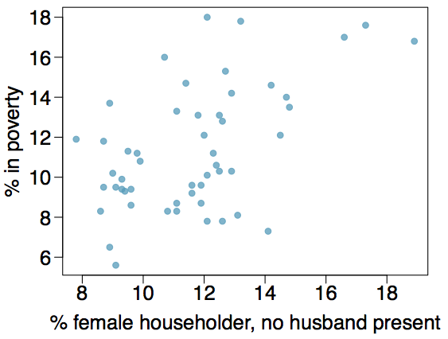
Guessing the correlation
Which of the following is the best guess for the correlation between percent in poverty and percent female householder?
0.1
-0.6
-0.4
0.9
0.5

Slide 24
Guessing the correlation
Which of the following is the best guess for the correlation between percent in poverty and percent female householder?
0.1
-0.6
-0.4
0.9
0.5

Slide 25
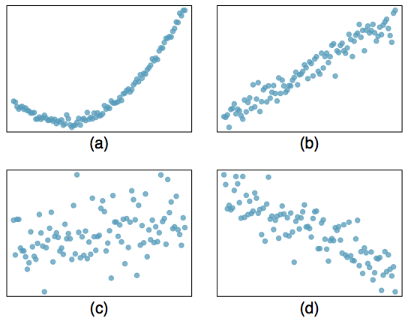
Assessing the correlation
Which of the following is has the strongest correlation, i.e. correlation coefficient closest to +1 or -1?

Slide 26
Assessing the correlation
Which of the following is has the strongest correlation, i.e. correlation coefficient closest to +1 or -1?
(b) → correlation means linear association

Slide 27
Find more resources at openintro.org/os, including
Slides
Videos
Statistical Software Labs
Discussion Forums (free support for students and teachers)
Learning Objectives
Teachers only content is also available for Verified Teachers, including
Exercise solutions
Sample exams
Ability to request a free desk copy for a course
Statistics Teachers email group
Questions? Contact us.

